Slide 1
5th Region F ICCWG meeting
Cádiz – Wednesday 12th June 2019
Presented by Cdr. PRONOST, Shom.
On behalf of Cpt. LOUVART, Region F RCC regionFcoord@shom.fr
Mediterranean and Black Seas Hydrographic Commission (MBSHC)

Slide 2
Region F ICCWG 5 - Agenda
ICC5-1 : Opening of ICCWG-5 meeting
ICC5-2 : Minutes of ICCWG-4 Meeting
ICC5-3 : Region F INT scheme status
ICC5-4 : ENC coverage status
ICC5-5 : ENC overlaps risk assessment
ICC5-6 : Region F ICCWG ToRs and RoPs
ICC5-7 : Priorities for the ICCWG and the new coordinator?
ICC5-8 : AOB / Closure of ICCWG-5 meeting

Slide 3
[ICC5-2] – Minutes of ICCWG-4
Approval of the ICCWG-4 Minutes
No comments received
ICCWG-4 Action list included in the MBSHC20 action list
Action N° | Action | Responsible | Update
MBSHC20/23 | RCC to disseminate the draft minutes of the ICCWG-4 meeting. | RCC | Done (09 March 2018)
Most MBSHC20 Actions regarding ICCWG business addressed alongside ICCWG-5 agenda

Slide 4
[ICC5-2] – Minutes of ICCWG-4
Action N° | Action | Responsible | Update
MBSHC20/08 | Member States and Associate members to ensure that the information on any requirements for ECDIS back-up arrangements using paper charts have been posted on the IHO website, and to update or give confirmation of no change at least once a year. | All | Permanent. Updates received from : GB, GR, HR, IT, RO, TN
MBSHC20/15 | To liaise with INToGIS Management team (IHO Secretariat) to retrieve their national account access details. | DZ, EG, MA, ME, SI, SY, TN | Done for DZ, EG, MA & TN
MBSHC20/16 | EG to propose a transition plan including procedure for reprint agreement prior to endorsement in the region F catalogue. | EG in liaison with UK | EG and GB are invited to use the MBSHC21 to work on the development of this transition plan

Slide 5
[ICC5-3] – Region F INT Scheme
Systematic use of INToGIS by producers to update already approved charts (schemed or produced) & to submit new proposals for inclusion in the catalogue
Updates received from DZ, ES, FR, GB, GE, HR, UA
Action N° | Action | Responsible | Update
MBSHC20/32 | New INT chart producers to provide Region F ICC with the INT charts iaw IRCC7 Decision3. | New INT producers | INT3872 (GE102), INT3873 (GE103) and INT3876 (GE104) received 2019/05/30. Permanent action.
MBSHC20/35 | MS to check and, if necessary, update their INT charts metadata (chart limit, title, year, format, scale, etc.) included in the region F INT catalogue using their INToGIS national account. | INT producers | Updates received from DZ, ES, FR, GB, GE, HR, UA

Slide 6
[ICC5-3] – Region F INT Scheme
➔ New version of the catalog v3.0.63 June 2019
Current catalog : 306 INT Charts
220 Produced & 86 Schemed
Feedback from producers on the use of INToGIS ?
 | Produced | Schemed
Overview | 15 | 0
General | 3 | 2
Coastal | 47 | 38
Approach | 45 | 11
Harbour | 91 | 27
Berthing | 19 | 8
Catalog v3.0.63 June 2019

Slide 7
[ICC5-3] – Region F INT Scheme
Action N° | Action | Responsible | Update
MBSHC20/36 | MS to submit their new INT chart proposals using their INToGIS national account. | INT producers | Proposals received from GR (Region F ICCWG CL 01 & 02/2019) & EG (MBSHC20/15)

Slide 8
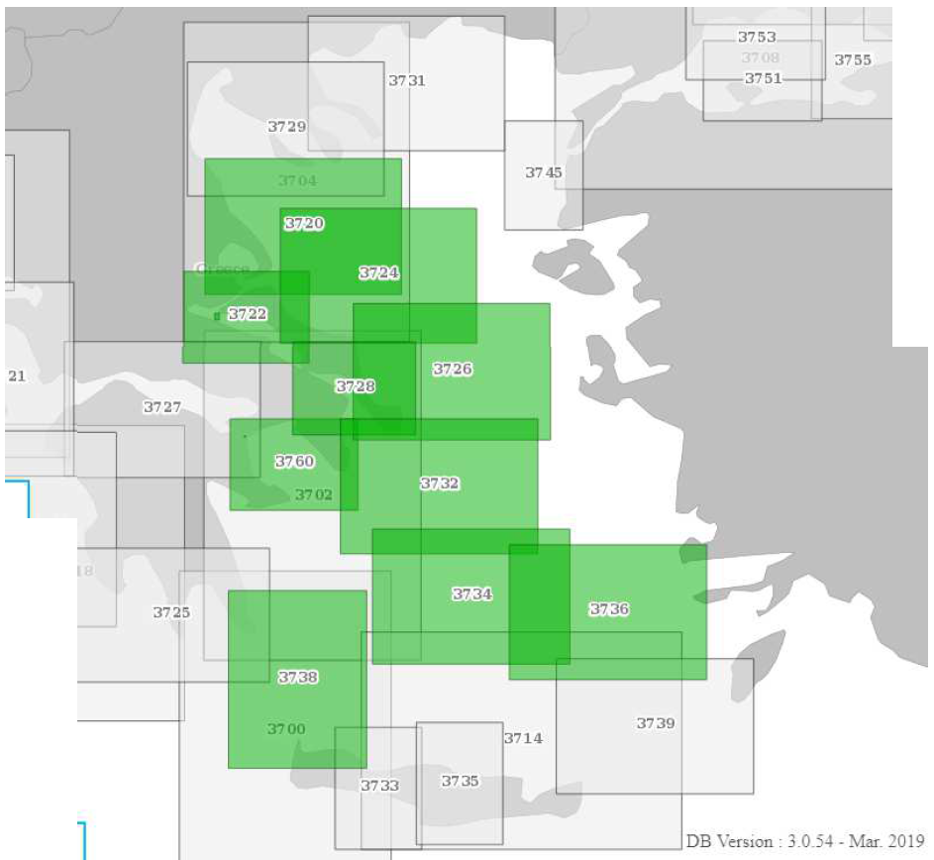
[ICC5-3] – Region F INT Scheme
Proposal to update the Region F INT scheme in Aegean sea
Region F ICCWG circular letter 01/2019 dated 11th March :
9 new INT charts proposed by GR (1:150 000 and 1:100 000), comments required by 5th April.
Objection from TR on 25th March, pointing out lack of justification

Slide 9
[ICC5-3] – Region F INT Scheme
Region F ICCWG circular letter 02/2019 dated 30th April : “It is recalled, as was already the case at the 4th meeting of the ICC WG (5 July 2017 - Montenegro), that the relevance of proposals for modification or addition to the INT scheme is first assessed by the regional coordinator before any submission to the ICC WG.
In the present case, these proposals were considered relevant by the regional charting coordinator as they allow to extend the INT scheme, which is still incomplete in the Aegean Sea with regard to the needs of international navigation “
→ modification approved by coordinator, to be proposed to MBSHC for approval

Slide 10
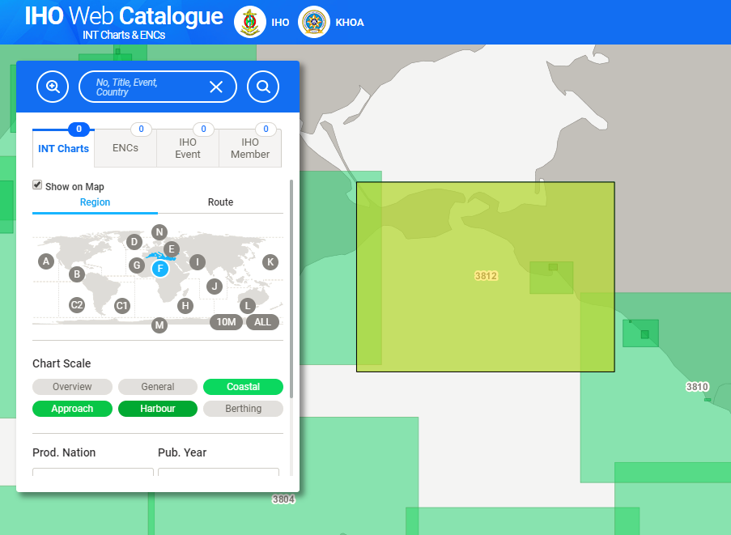
[ICC5-3] – Region F INT Scheme
Black and Azov Seas INT Scheme – Pending charts
INT3812 (Agreed INT Scheme)
Should be co-produced by RF (RU32172) and UA (UA3228).
BASWG14 : UA reports that this co-production is not effective and currently impossible with RU.
UA reissued the INT3812 chart in Sept. 2017 (First Edition 2004).
No information received from RU
Scale 1 : 300 000
But no higher scale available
INToGIS II

Slide 11
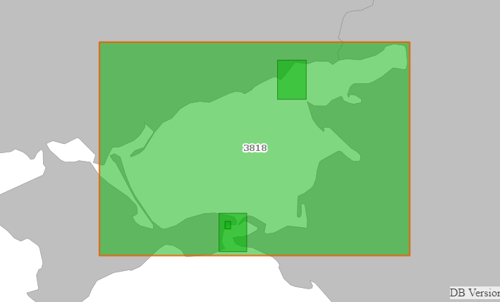
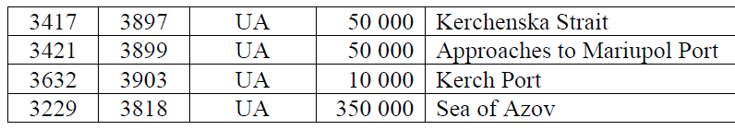
[ICC5-3] – Region F INT Scheme
Black and Azov Seas INT Scheme – Pending charts
Request from UA to produce 4 INT Charts
  Currently not assigned on INToGIS, no discussion between RU & UA on these 4 charts on the last 3 years.
Proposed MBSHC action : Record UA request to produce these 4 charts
INT3818
INT3899
INT3897
INT3903

Slide 12
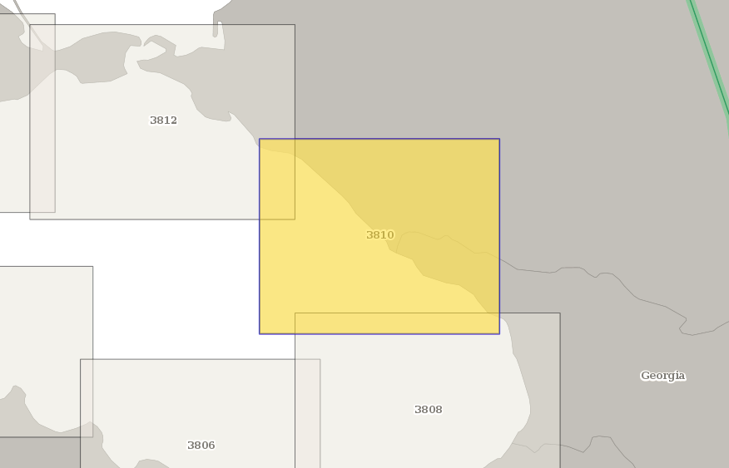
[ICC5-3] – Region F INT Scheme
Black and Azov Seas INT Scheme – Pending charts
Request from GE to co-produce INT3810 (BASWG13/05)
  INT3810 is currently produced by RF (RU 32173)
  BASWG13 : It was agreed that GE to liaise with RU regarding co-production of INT3810 and INT3875 and report back to the Region F ICC until the next MBSHC meeting
  BASWG14 : GE reports no progress towards a co-production of this chart

Slide 13
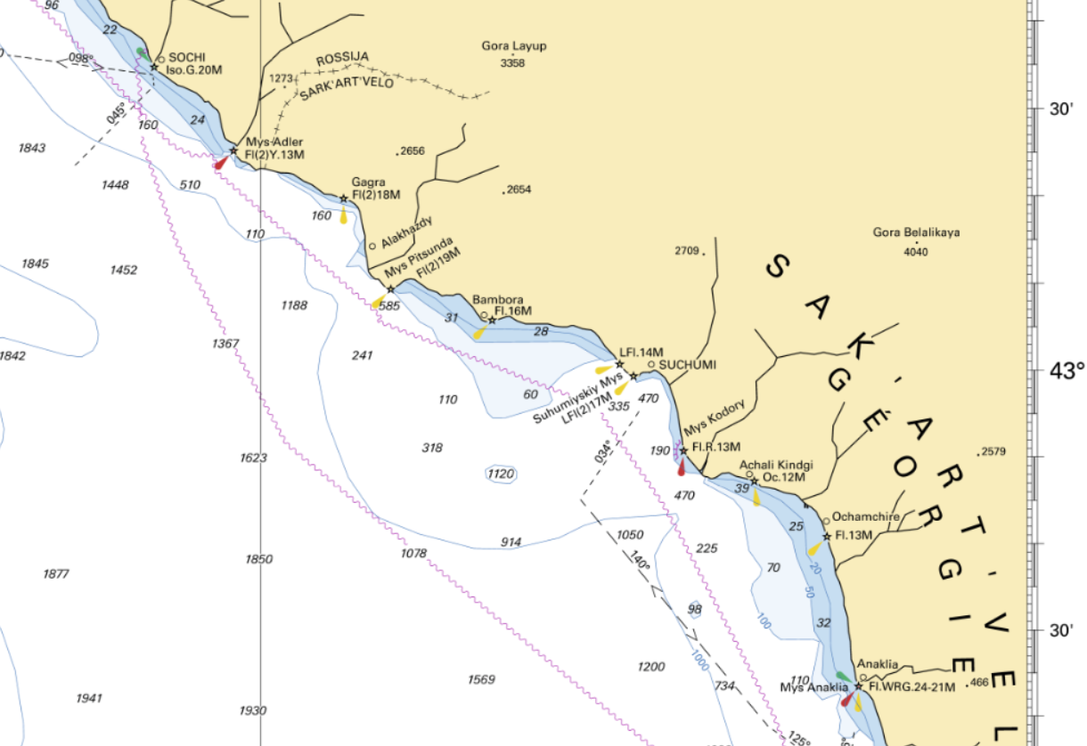
[ICC5-3] – Region F INT Scheme
Black and Azov Seas INT Scheme – Pending charts
Request from GE to produce the INT chart covering Soukhumi port with Approaches (GE108) (BASWG13/05)

Slide 14
[ICC5-3] – Region F INT Scheme
Black and Azov Seas INT Scheme – Pending charts
Request from GE to produce the INT chart covering Soukhumi port with Approaches (GE108) (BASWG13/05)
  2009 : MBSHC16, RU proposed to abort producing this chart due to lack of information.
  BASWG recommended to wait until GE is a full IHO member to achieve the transfer.
  2015 : GE became an IHO Member.
  2016 : Region F IRCCWG CL 01/2016, RU objected to the assignation of production to GE
  Due to lack on consensus on this INT chart, it is currently not assigned
  Proposed MBSHC action : Record GE request to produce the INT chart of Soukhumi.

Slide 15
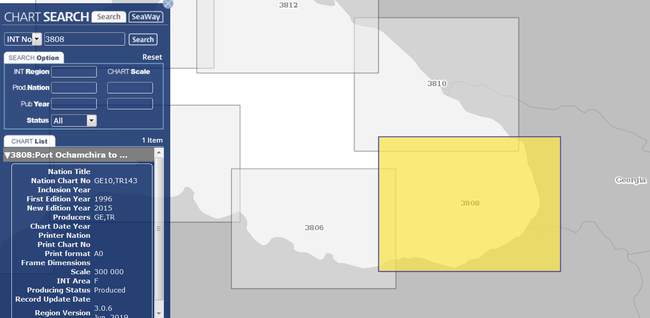
[ICC5-3] – Region F INT Scheme
INT3808 Chart
RF printer : with new information from recent surveys to be passed (repromats,…) to co-producers TR/GE

Slide 16
[ICC5-3] – Region F INT Scheme
Western Mediterranean INT Scheme (ES proposal)
Action N° | Action | Responsible | Update
MBSHC20/37 | ICCWG-F to confirm the transfer of INT3102, INT3108, INT3110 and INT3112 to the Western Mediterranean small scale INT scheme (see decision MBSHC20/06). | ICCWG-F

Slide 17
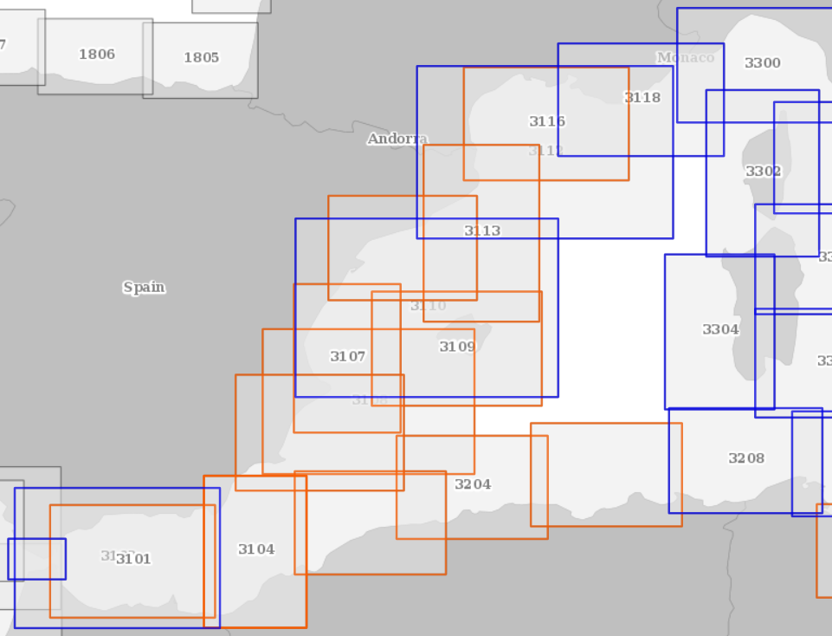
[ICC5-3] – Region F INT Scheme
Western Mediterranean INT Scheme (SP proposal) :
Is there a need to keep
INT3112 and INT3110 (1:425 000),
INT3108 and INT3102 (1:350 000)
when the 1:275 000 / 1:250 000
charts are produced by ES?

Slide 18
[ICC5-4] – ENC coverage status
Action N° | Action | Responsible | Update
MBSHC20/17 | MS to use the IHO online port database to update their port priority list and report to the Regional Charting Coordinator (RCC). | All | Updates received from CY, DZ, ES, EG, FR, GB, GE, GR, HR, IT, RO and UA
MBSHC20/18 | RCC to disseminate an updated version of the Port priority list. | RCC | Report of the feedback received transmitted to the members of ICCWG, Sec IHO and NGA.
Regarding actions MBSHC20/17 and 18: the new functionalities offered by INToGIS could enable new, more interactive actions

Slide 19
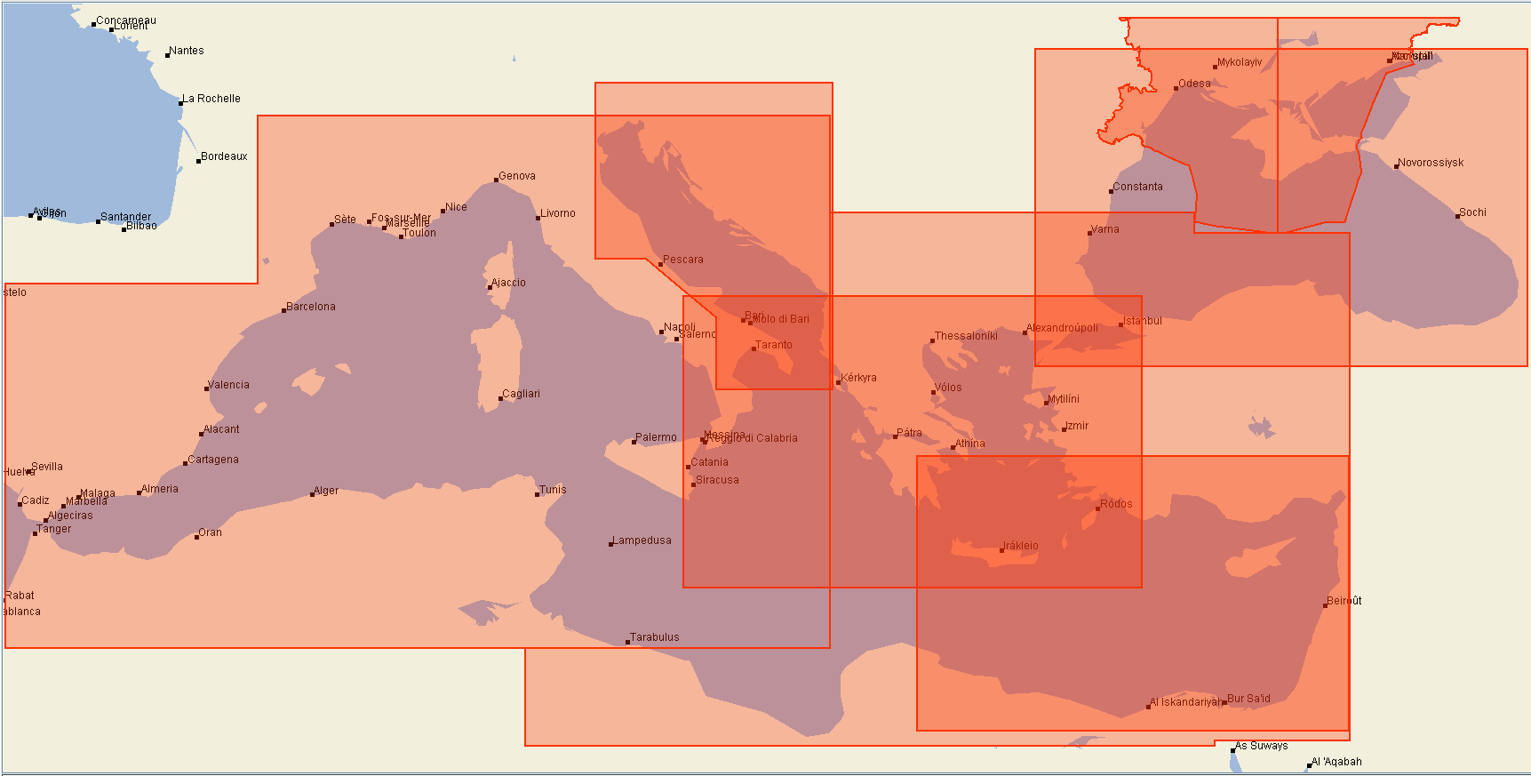
[ICC5-4] – ENC coverage status
UB1 : 8 cells
Source : PRIMAR Chart Catalogue

Slide 20
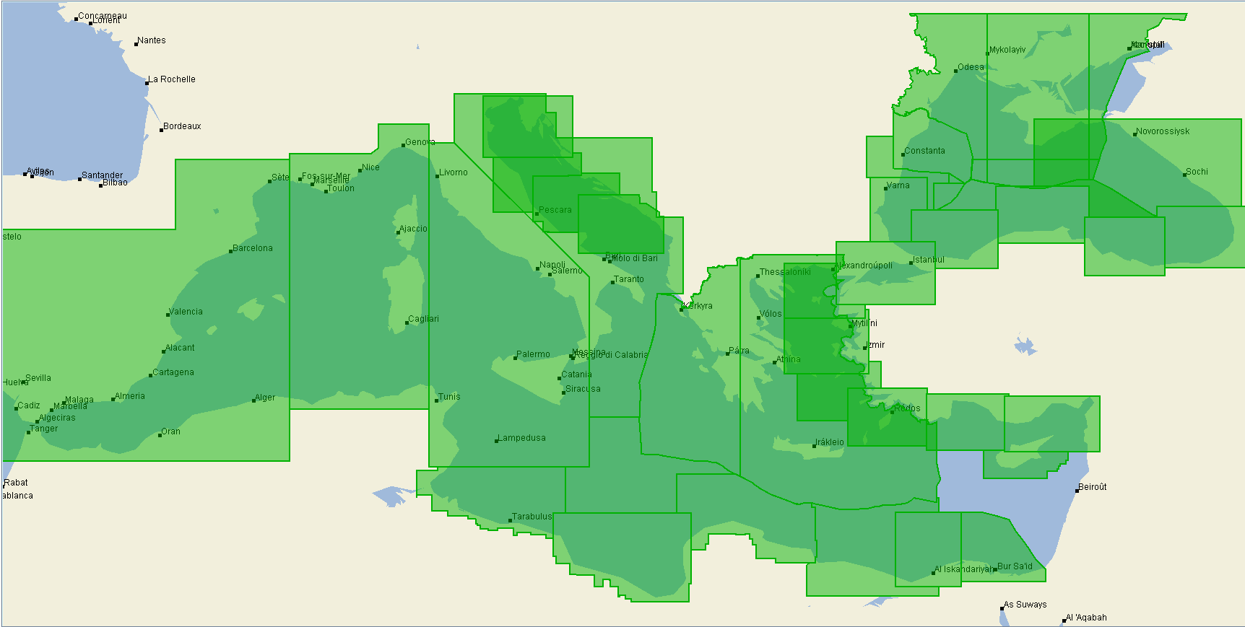
[ICC5-4] – ENC coverage status
UB2 : 43 cells
Source : PRIMAR Chart Catalogue

Slide 21
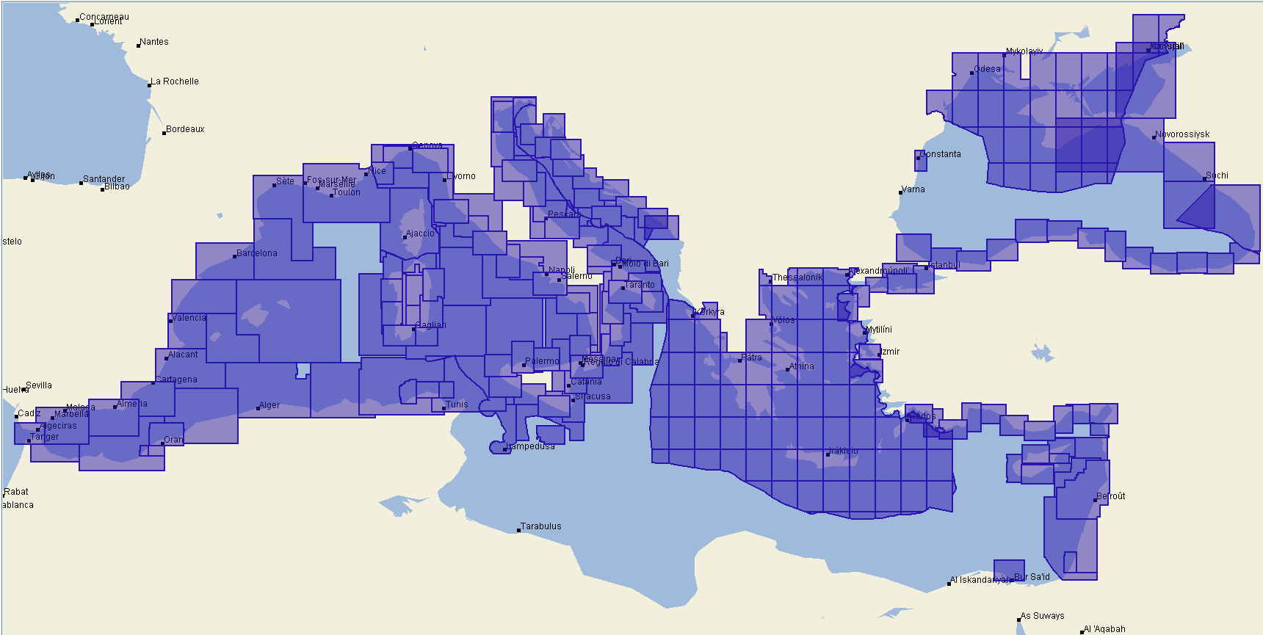
[ICC5-4] – ENC coverage status
UB3 : 280 cells
Source : PRIMAR Chart Catalogue

Slide 22
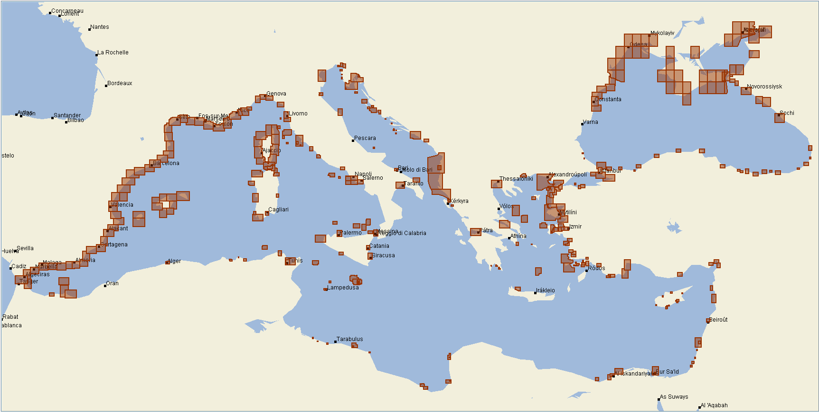
[ICC5-4] – ENC coverage status
UB4 : 346 cells
Source : PRIMAR Chart Catalogue

Slide 23
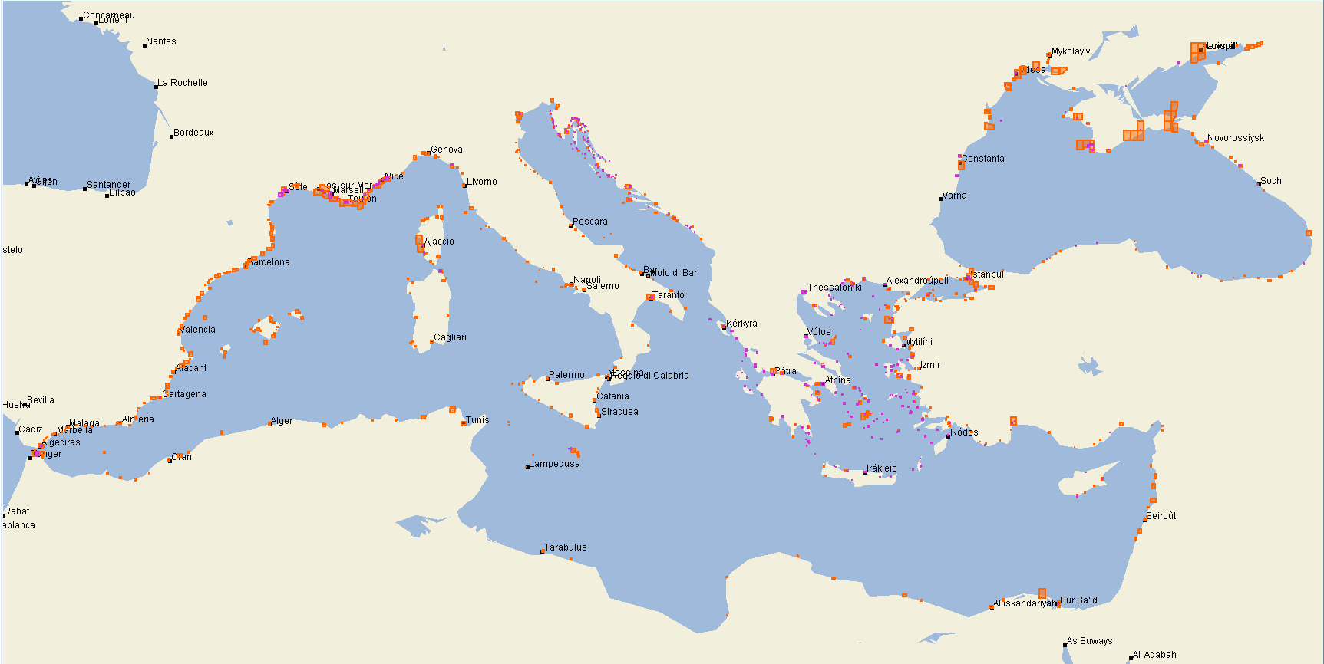
[ICC5-4] – ENC coverage status
UB5 : 579 cells
UB6 : 407 cells
Source : PRIMAR Chart Catalogue

Slide 24
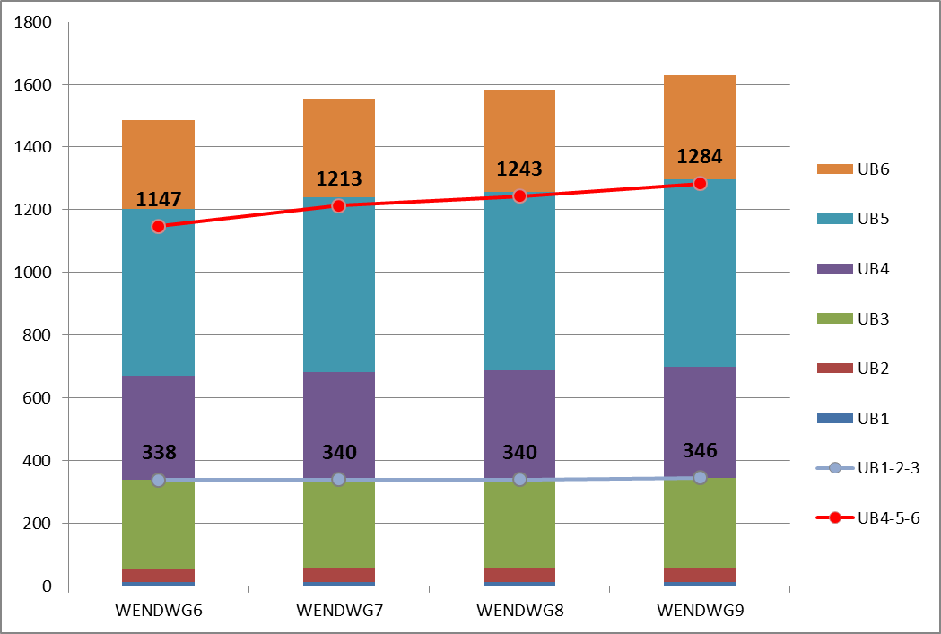
[ICC5-4] – ENC coverage status
Region F | WEND-6 | WEND-7 | WEND-8 | WEND-9
UB1 | 12 | 12 | 12 | 12
UB2 | 44 | 46 | 46 | 46
UB3 | 282 | 282 | 282 | 288
UB4 | 333 | 343 | 349 | 353
UB5 | 533 | 558 | 569 | 599
UB6 | 281 | 312 | 325 | 332
Total | 1485 | 1553 | 1583 | 1630
Number of UB1-2-3 ~ stable in the last 3 years
UB4  6% in the last 3 years (1% last year)
UB5  12% in the last 3 years (5% last year)
UB6  18% in the last 3 years (2% last year)
Source : WEND Global ENC coverage - 2019

Slide 25
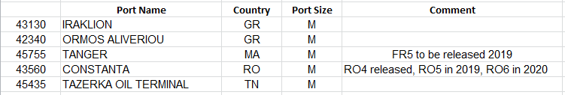
[ICC5-4] – ENC coverage status
UB1 and UB2 coverage considered as completed
UB3 coverage with persistent gaps on the Southern shore of the Mediterranean Sea
UB4/5/6 : still some ports from NGA World Port Index (Pub150) not covered
eg. 5 Medium ports :
Source : PRIMAR Chart Catalogue

Slide 26
[ICC5-5] – ENC overlap risk assessment
Action N° | Action | Responsible | Update
MBSHC20/19 | Concerned MSs to liaise bilaterally to resolve ENC overlappings, keeping the MBSHC Chair informed. | IT, GR, TR & HR | Little progress noted. Actions undertaken by IT and HR to resolve overlaps, overlaps in the process of being resolved. No information received on possible actions taken by GR and TR to resolve the many overlaps affecting the region. Should be a permanent action for all ENCs producers.
MBSHC20/21 | RENCs to provide a template report in order to collect the evaluation of risk level on ENC overlaps from the MS in the frame of the WENDWG risk assessment experimentation. | RENCs | Latest version (WEND9) sent to all ICCWG Members
MBSHC20/22 | MS to use the RENCs’ template report to provide the RCC with: evaluation of risk level on the most critical ENC overlaps based on the IC-ENC risk assessment regional database (level: MEDIUM); their views and comments on the IC-ENC risk assessment methodology. | All | Returns received from GB, GE, GR, IT, RO, SI and TR IC-ENC overlap report

Slide 27
[ICC5-5] – ENC overlap risk assessment
Region F affected by persistent overlap
Overlaps concern all usage bands
Primar overlap checker ‘Hits’
  For each entry cell, the total number of overlapped cells (other producers & own overlap) is counted
  ‘OO’ = Own Overlap, each instance is counted
Example
6 ‘Hits’ & 4 ‘OO’
4 ‘Hits’ & 2 ‘OO’

Slide 28
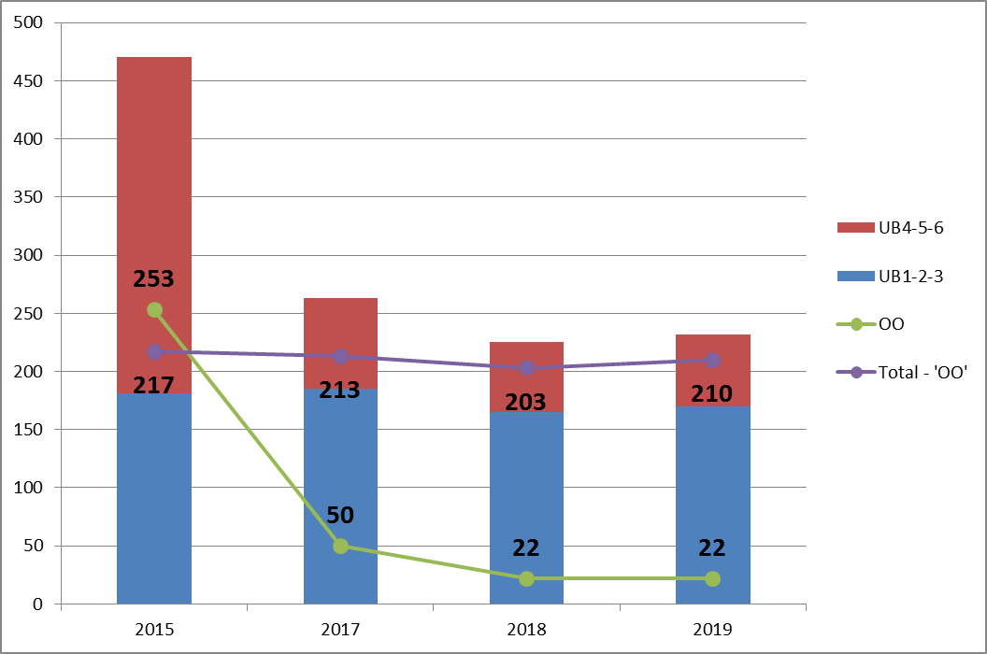
[ICC5-5] – ENC overlap risk assessment
Primar overlap checker ‘Hits’
Significant reduction between 2015 and 2017 (470  263) mainly due to a massive reduction of the own overlaps (253  50)
Slight decrease between 2017 and 2018 (213  203)
Number of “real” ‘hits’ is on the rise again (203  210)

Slide 29
[ICC5-5] – ENC overlap risk assessment
IC-ENC Overlap report
March 18 > June 19
Resolved (and Acceptable) overlaps  :
Mechanisms put in place at the RENC level are working
Low & Medium overlaps persist
Potential overlaps 
Coordination between producers still insufficient
Region F | March 2018 | June 2019
Resolved | 36 | 71
Accept | 3 | 15
Potential | 37 | 50
LOW | 81 | 81
MEDIUM | 24 | 24
HIGH | 0 | 0
Total | 181 | 241

Slide 30
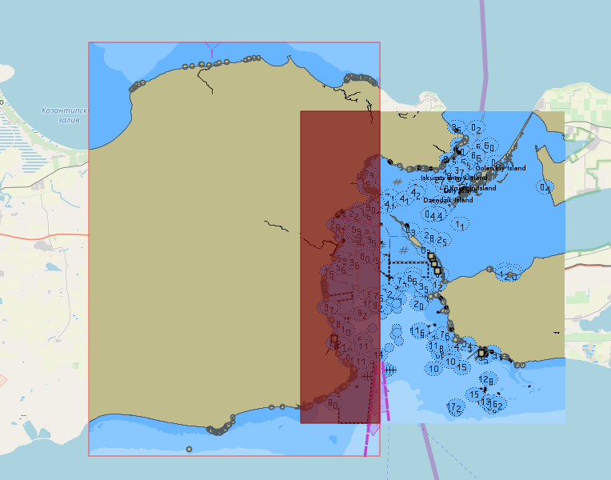
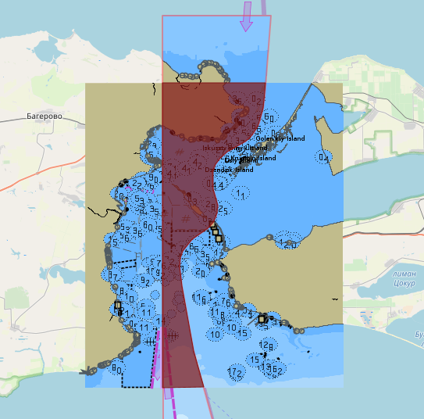
[ICC5-5] – ENC overlap risk assessment
RU4MFLJO & UA4CC883
Highest risk case :
Example :
RU4MFLJO & UA4CC883
RU4MFLJO & UA4CC884
IC-ENC Risk analysis ➔ Medium
But critical location of the overlap (main route through Kerch Straits & anchorage areas)
→ To be resolved
RU4MFLJO & UA4CC884

Slide 31
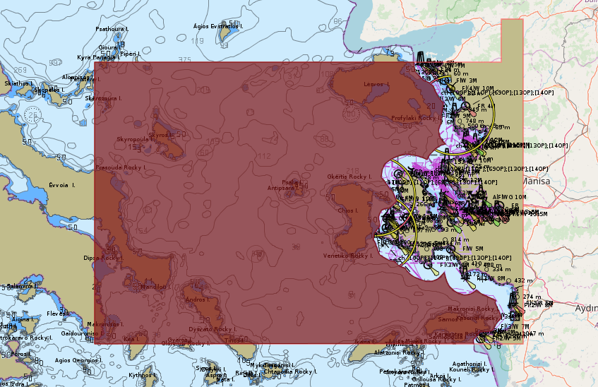
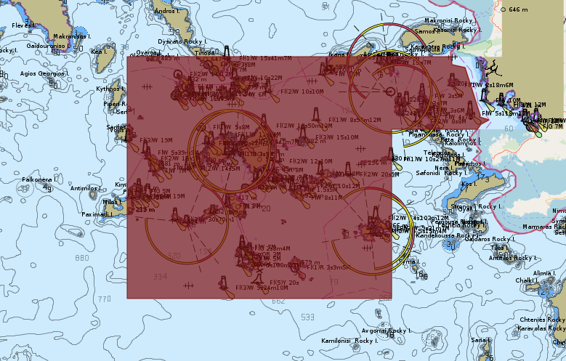
[ICC5-5] – ENC overlap risk assessment
GR2AF7UH & TR20022B
Highest risk case
Example :
GR2AF7UH & TR20022B
GR2AF7UH & TR20022A
IC-ENC Risk analysis ➔ Medium
GR analysis : High
TR analysis : Low
CC : high risk of inconsistency between cells due to lack of coordination between producers
→ To be resolved
GR2AF7UH & TR20022A

Slide 32
[ICC5-6] – Region F ICCWG ToRs & RoPs
ToRs and RoPs were revised in 2017 and approved by MBSHC20.
No points were raised to revise them again

Slide 33
[ICC5-7] – Priorities for the ICCWG ?
What priorities for the ICCWG and the new ICC ?
  Continue updating the INT chart scheme or freeze the current scheme?
  Full implementation of the ENC scheme?
  Promotion of the S-100 series?

Slide 34
[ICC5-8] – AOB & Closure
Documents concerning the group are collected on a restricted page of the commission's web page, which limits the diffusion of information
It is proposed to put the documents (CL, Correspondence, Presentations) on an open access page of the commission and to keep only the archived versions of old catalogues on the restricted access page.
Closure / Thank you for your participation !

Slide 35
Thank you

Slide 36
Action requested from the MBSHC
The MBSHC is invited to :
Take note of the Region F RCC report
XXX
6 – Coordination of Regional Charting

